Slide 1
SOME Electricity Billing System
Prepared By,
Sadman Sakib Khan Promit

Slide 2
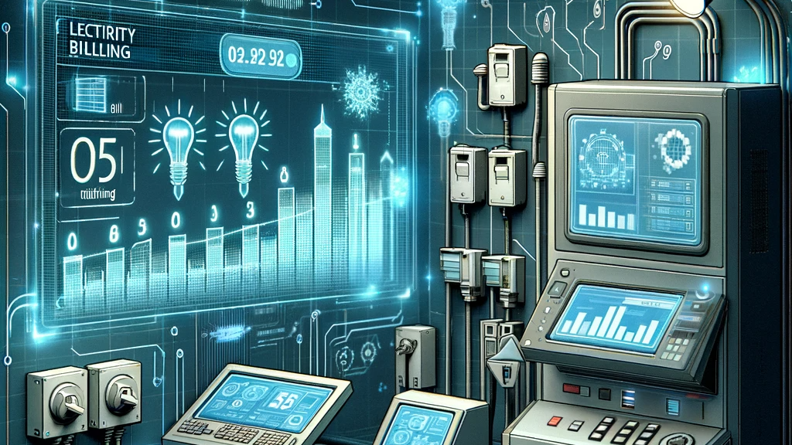
Objectives of This Project
Purpose
Cloning of SOME Billing System
Integration
Can integrate with existing system architecture
Features
Automated billing
customer support

Slide 3
Functional Requirements
Admin
Create/Manage accounts
Edit rates
Generate Bills
Customer
Create account
View Bills
Bank
Change Status

Slide 4
Non-Functional Requirements
Security
Password hashing
Authentication
Scalability & Usability
Handling data efficiently
Handling users efficiently
Performance & Reliability
Consistent user request handling
Accessibility
User-friendly interface

Slide 5
System Overview
Functionality-wise Prototype Description
Overview
Cloning of SOME Billing System
Integration
Can integrate with existing system architecture
Features
Automated billing
Customer support

Slide 6
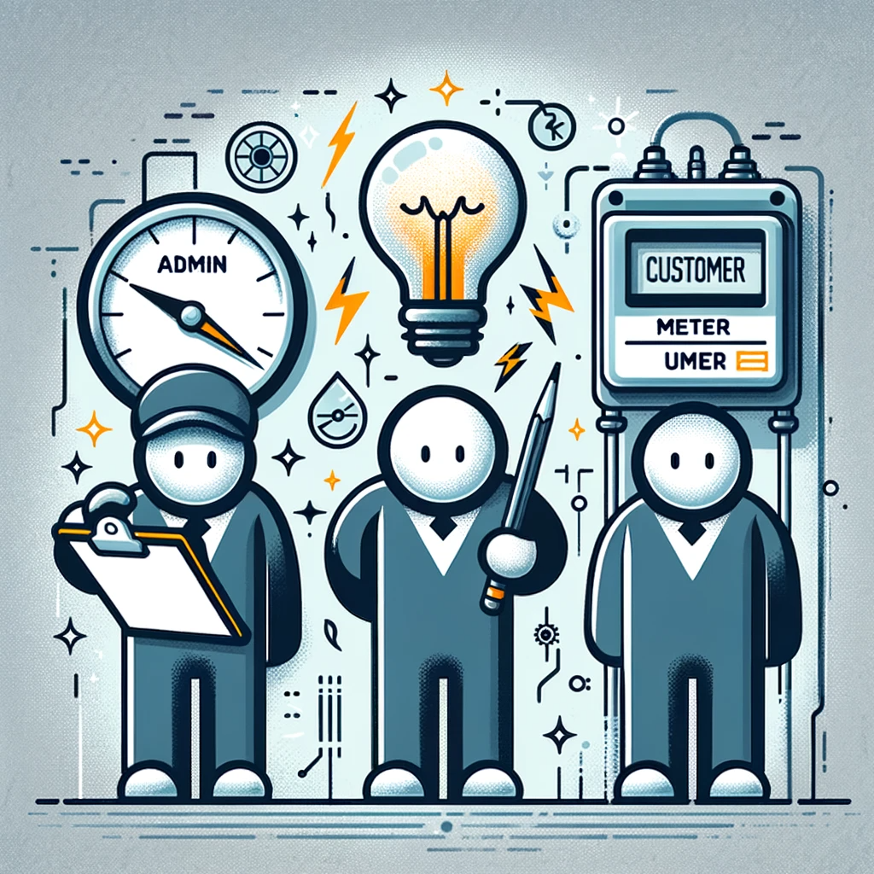
User Classes and Characteristics
User Types
Customers
Admin Staff
Meter (System)

Slide 7
Technical Implementation
Backend
Flask
SQLAlchemy
Frontend
HTML
CSS (Vanilla)
JavaScript (Vanilla)
Security
Werkzeug for password hashing

Slide 8
Conclusion and Future Scope
Conclusion
Automation of utility management
Successfully integrates comprehensive functionalities for various user roles
Efficient management of billing and customer service
Enhancing operational efficiency
Future Scope
Integration with Smart Meters
Mobile Application Development
Advanced Analytics
AI-Driven Predictive Maintenance
Green Energy Options

Slide 9
Acknowledgements and References
Acknowledgements
Respected faculty member and the university for this great project!
References
https://www.perforce.com/blog/alm/how-write-software-requirements-specification-srs-document
https://www.geeksforgeeks.org/software-requirement-specification-srs-format/
IEEE Guide to Software Requirements Specifications (SRS).
SOME's Existing System Documentation and API Guides.
Best Practices in Utility Billing Management Systems.

